Slide 1
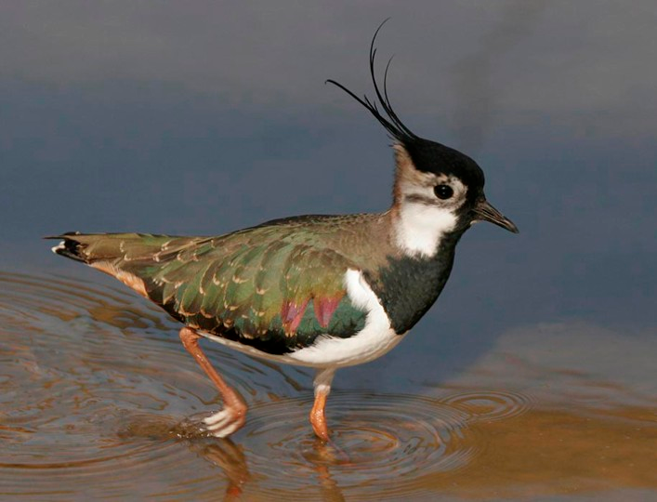
Saving species: Turning understanding into action

Slide 2

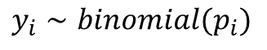
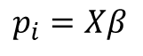
Did you drink coffee this morning?
Utterly trivial and simple question.
The data will be yes or no (1 or 0).
Given your answer, the more interesting question is why did you drink coffee (or not)?
There is some unknown probability that you will drink coffee, which is determined by some unknown influences.
$$y_{i}∼binomial(p_{i})$$
$$p_{i}=Xβ$$

Slide 3
Why did you drink coffee this morning (or not)?
No one randomly chooses to drink coffee (no “lol so random” crap here).
That decision is determined based on an entire process! E.g.;
Do you parents drink coffee?
Did you watch TV were mature characters drank coffee?
Did you want to emulate these characters?
Are you from a culture where drinking coffee in the morning is normal?
Do you drink tea instead of coffee?
Are you hungover?
Do you believe drinking coffee helps with a hangover?
Did you see a butterfly this morning, which reminded you of your grandmother’s room which had butterflies in the wallpaper, and your grandmother used to grind coffee by hand, and did you become nostalgic for your grandmothers coffee?
And so, so, so many more potential variables which drove you to your decision this morning.
The aim of causal statistics is to try and capture the true causal relationships of this process.

Slide 4
Think before you run!!!
Adding covariates (i.e., “factors”) to a model is easy.
There are tools available to help you choose which the “most important” variables are (but these carry huge risks).
Thinking about what to add to a model is much harder – but this is why you’ve had four years to learn biology!
Do not throw out those four years of training you’ve had just to fit a model!
The aim of causal statistics is to try and capture the true causal relationships of this process.

Slide 5
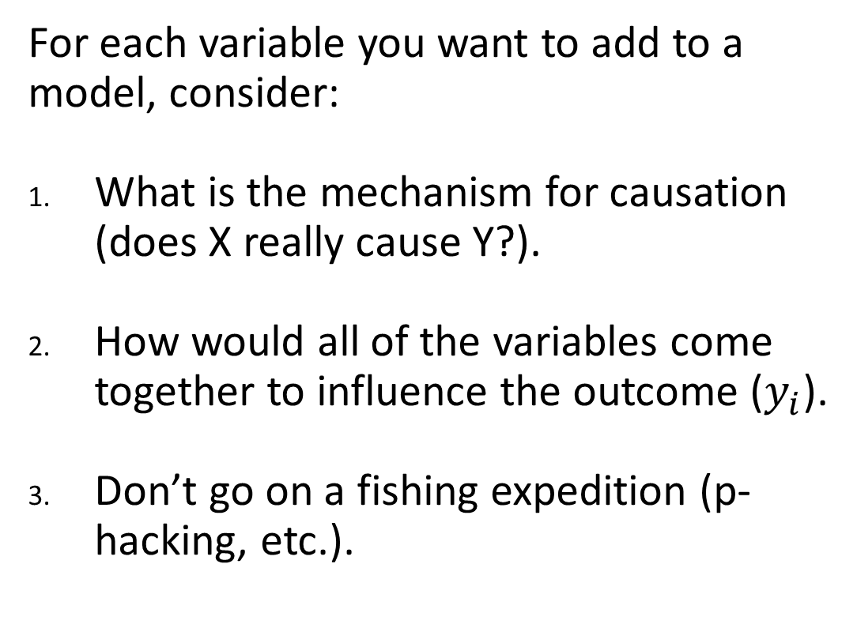
Use biology to build models, not statistics
For each variable you want to add to a model, consider:
What is the mechanism for causation (does X really cause Y?).
How would all of the variables come together to influence the outcome ($y_{i}$).
Don’t go on a fishing expedition (p-hacking, etc.).
The aim of causal statistics is to try and capture the true causal relationships of this process.

Slide 6
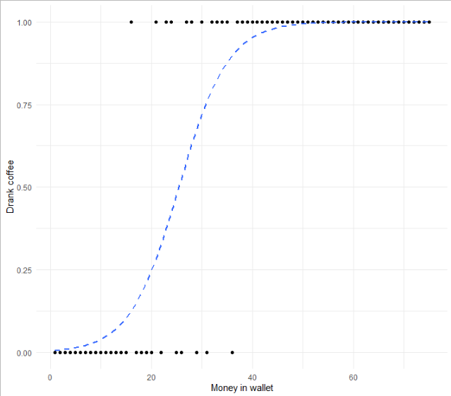
Do you trust my model?
$$\operatorname{Pr}\left(Drink Coffee\right)∝Money in wallet$$
What is the mechanism that causes you to buy a coffee, 100% of the time, if you have > £50 in your wallet?
The aim of causal statistics is to try and capture the true causal relationships of this process.

Slide 7
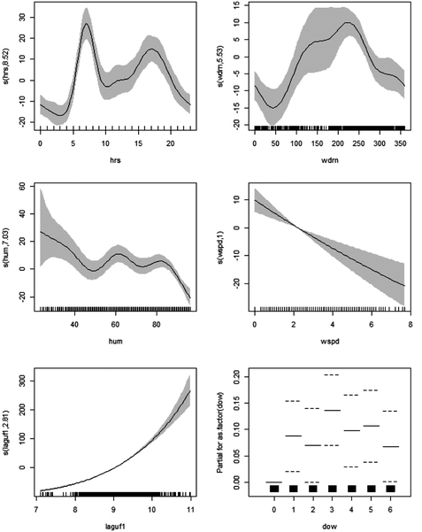
To save species you must know some stats

Slide 8
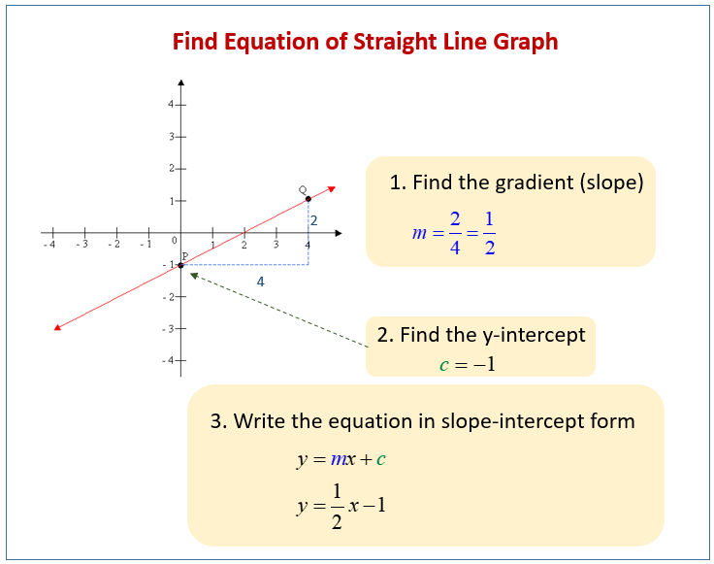
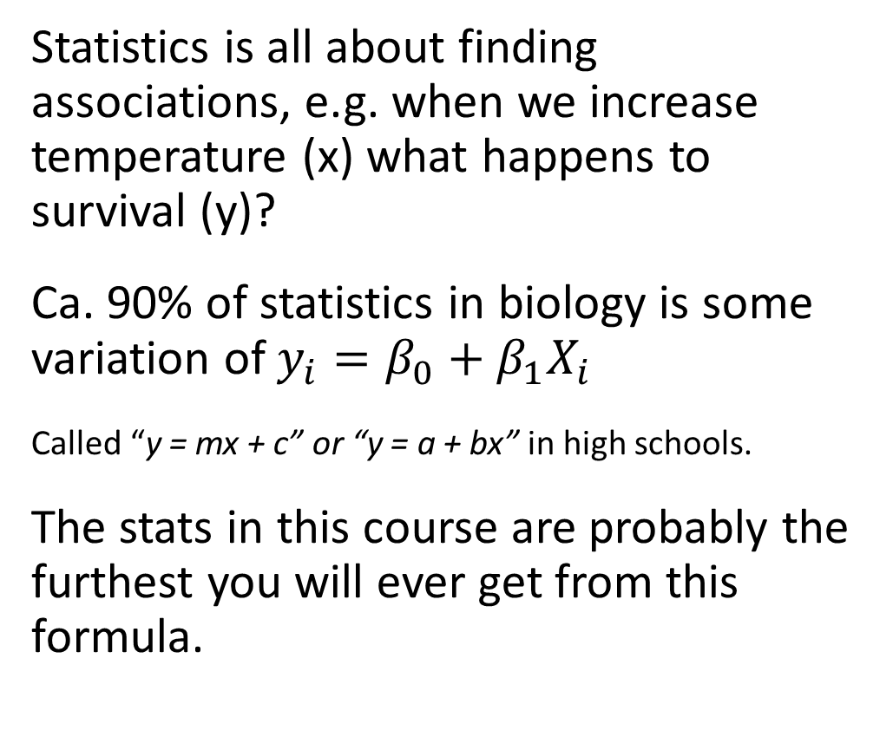
Stats: making the simple seem really complicated
High-school maths revision
Statistics is all about finding associations, e.g. when we increase temperature (x) what happens to survival (y)?
Ca. 90% of statistics in biology is some variation of $y_{i}=β_{0}+β_{1}X_{i}$
Called “y = mx + c” or “y = a + bx” in high schools.
The stats in this course are probably the furthest you will ever get from this formula.

Slide 9
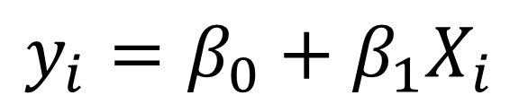
Statistics and data
$$y_{i}=β_{0}+β_{1}X_{i}$$
Continuous (e.g. height)
Observed
Grouped
(e.g. eye colour)
Data
Unobserved
“Parameter”

Slide 10
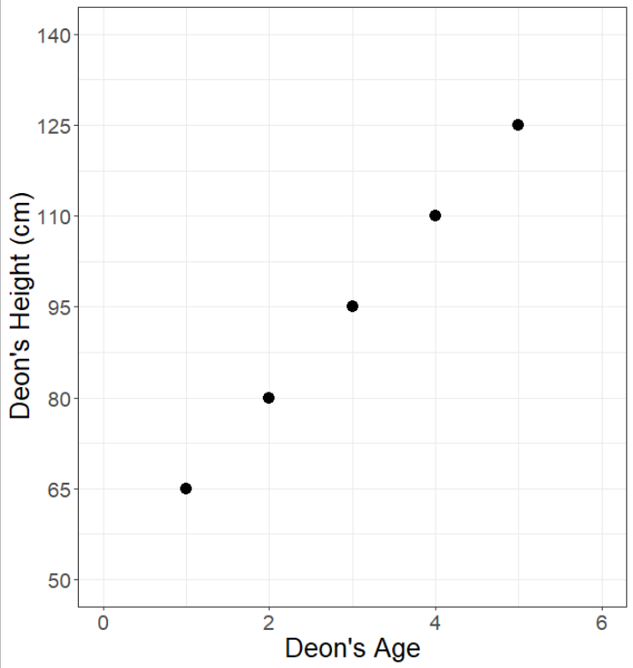
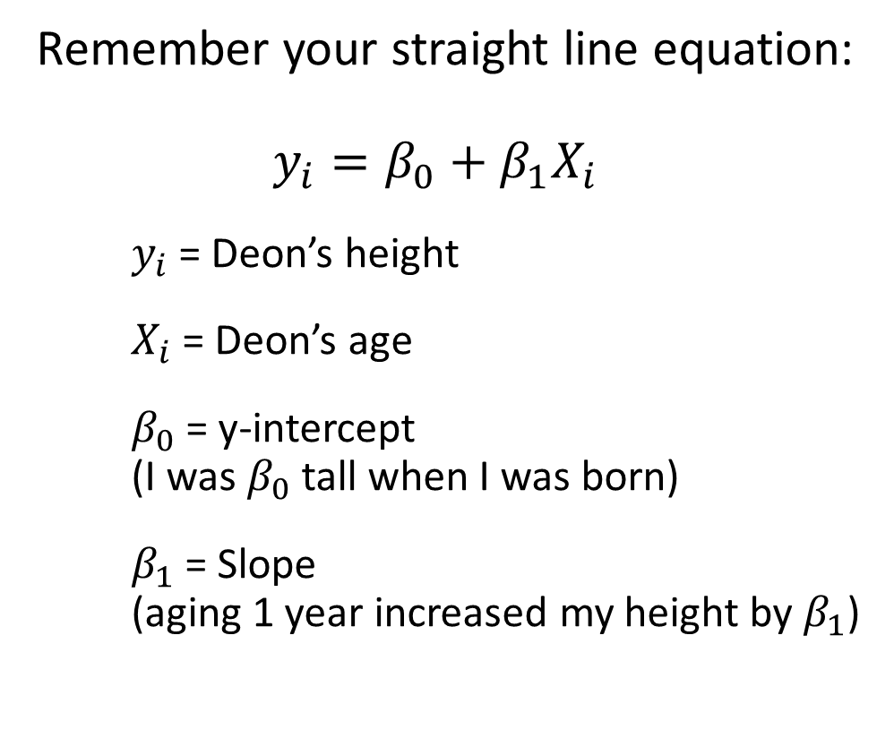
Doing statistics by hand
Remember your straight line equation:
$$y_{i}=β_{0}+β_{1}X_{i}$$
$y_{i}$ = Deon’s height
$X_{i}$ = Deon’s age
$β_{0}$ = y-intercept (I was $β_{0}$ tall when I was born)
$β_{1}$ = Slope (aging 1 year increased my height by $β_{1}$)
Observed data
Unobserved data

Slide 11
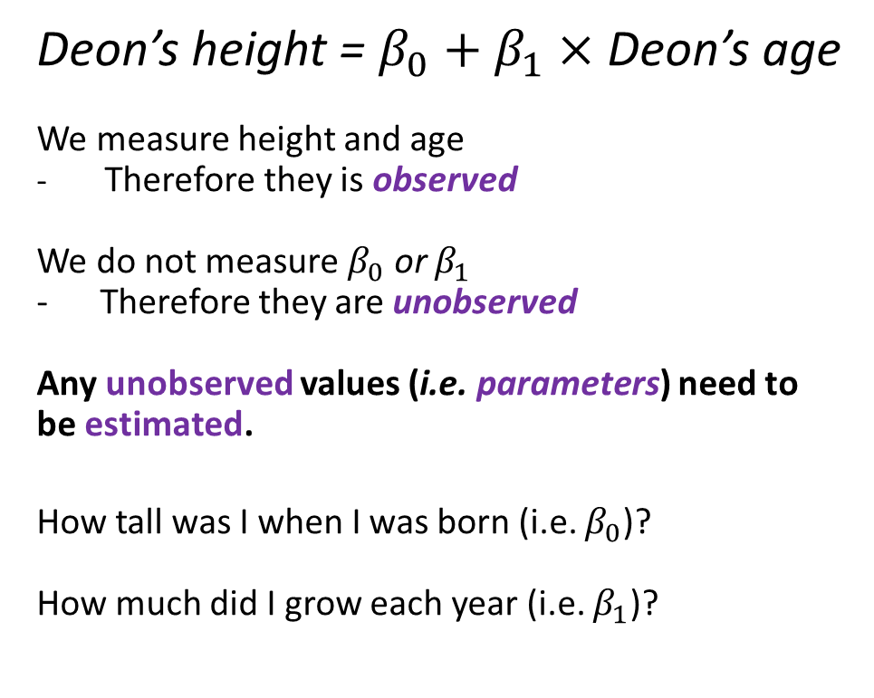
Stats by hand
Deon’s height = $β_{0}$ $+$ $β_{1}×$ Deon’s age
We measure height and age
Therefore they is observed
We do not measure $β_{0}$ or $β_{1}$
- Therefore they are unobserved
Any unobserved values (i.e. parameters) need to be estimated.
How tall was I when I was born (i.e. $β_{0}$)?
How much did I grow each year (i.e. $β_{1}$)?

Slide 12
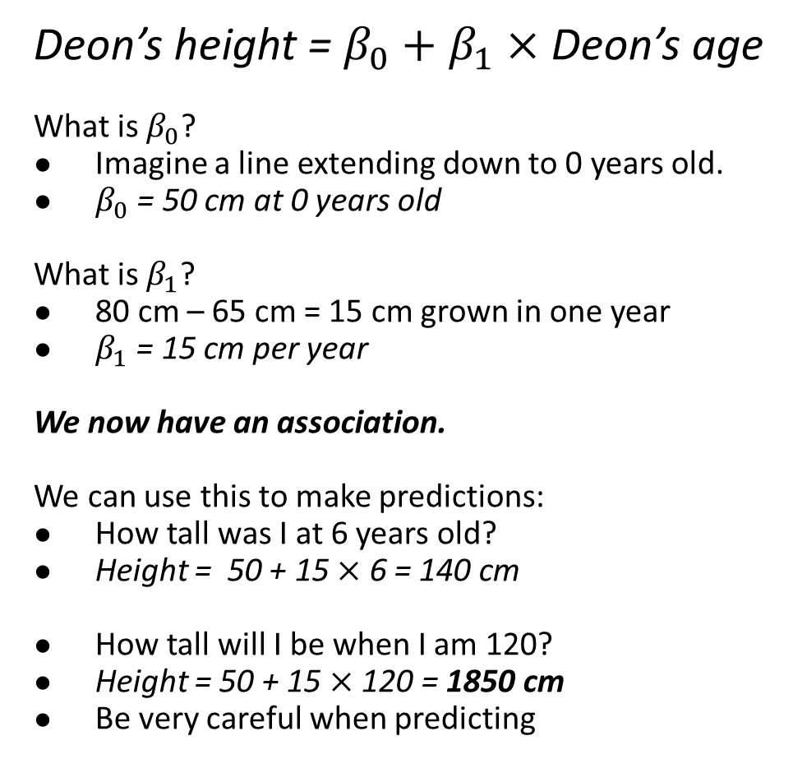
Stats by hand
Deon’s height = $β_{0}+β_{1}×$ Deon’s age
What is $β_{0}$?
Imagine a line extending down to 0 years old.
$β_{0}$ = 50 cm at 0 years old
What is $β_{1}$?
80 cm – 65 cm = 15 cm grown in one year
$β_{1}$ = 15 cm per year
We now have an association.
We can use this to make predictions:
How tall was I at 6 years old?
Height = 50 + 15 $×$ 6 = 140 cm
How tall will I be when I am 120?
Height = 50 + 15 $×$ 120 = 1850 cm
Be very careful when predicting
You will never see data with such a “clean” relationship in the real world. If you do, it’s almost certainly fake.

Slide 13
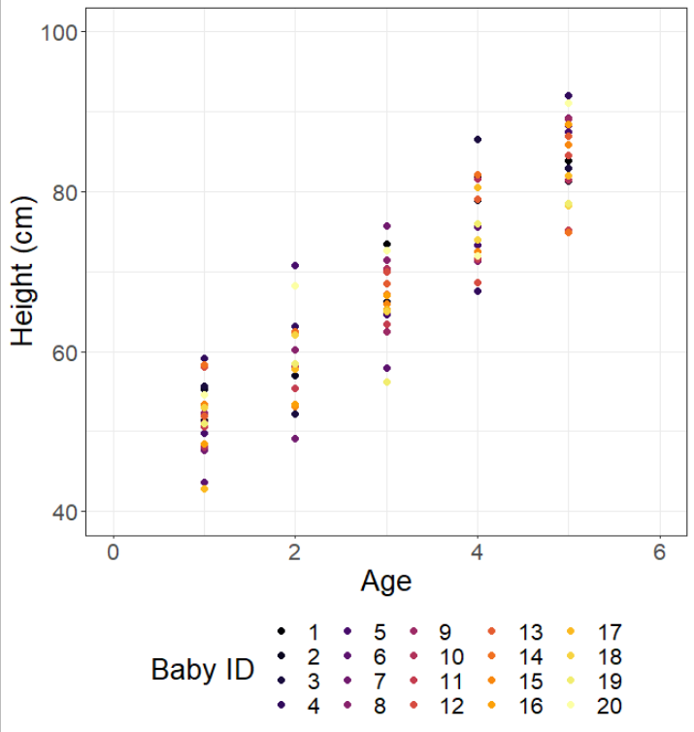
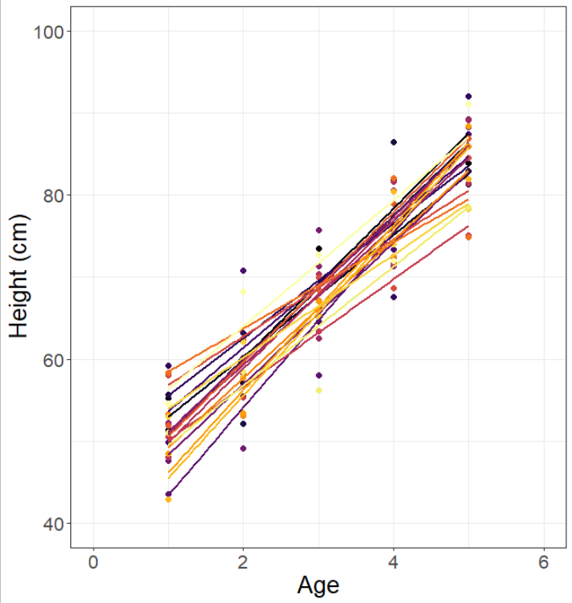
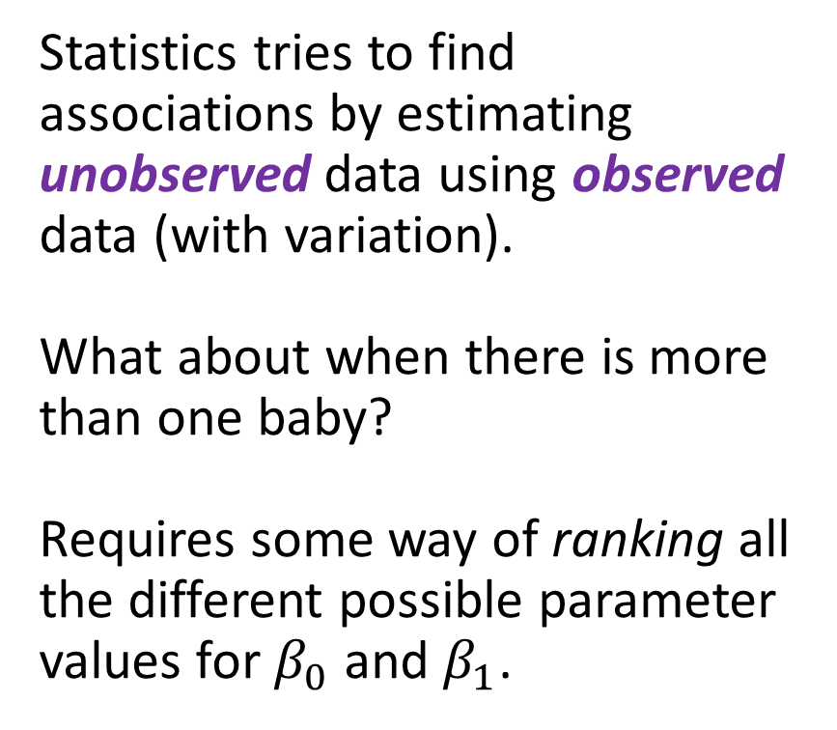
More realism
Statistics tries to find associations by estimating unobserved data using observed data (with variation).
What about when there is more than one baby?
Requires some way of ranking all the different possible parameter values for $β_{0}$ and $β_{1}$.

Slide 14
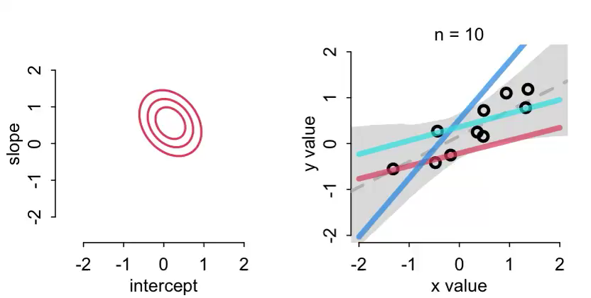
Maximum Likelihood Estimate - Briefly
An “algorithm”(left intentionally vague) which tries different values for all parameters. It “choses” those values which best match the observed data.

Slide 15
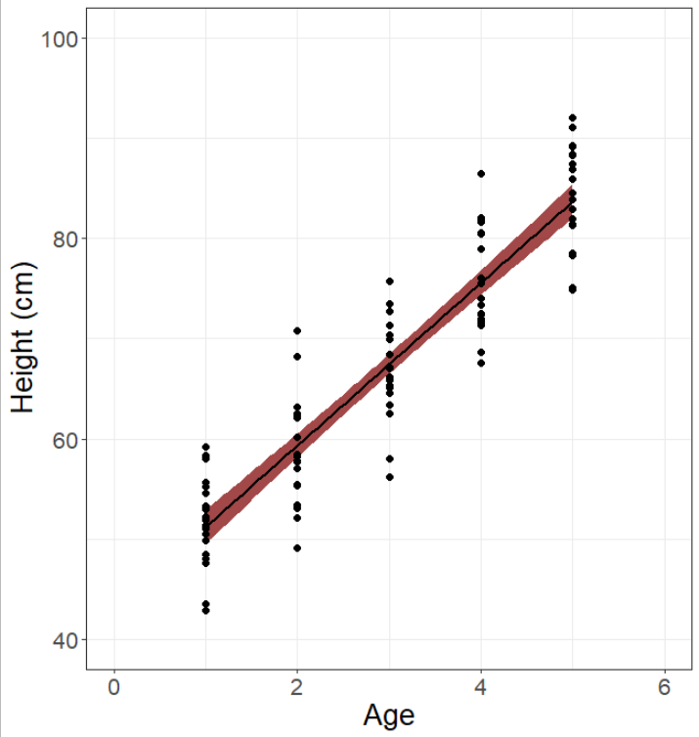
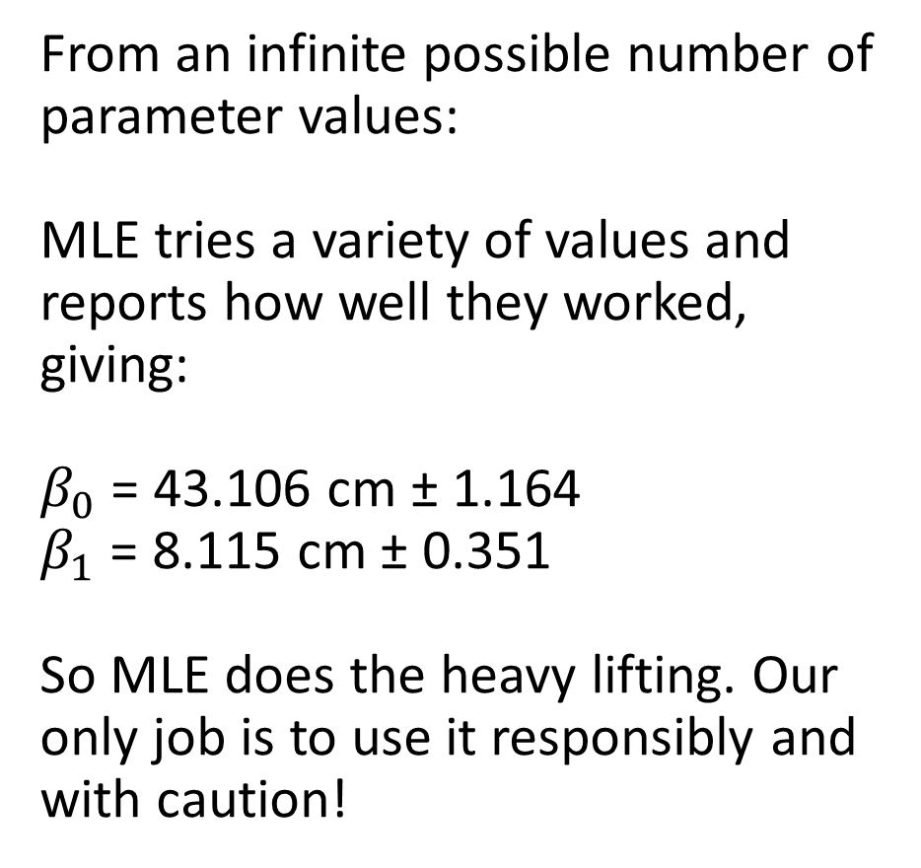
So what does MLE estimate? (Abstract summary)
From an infinite possible number of parameter values:
MLE tries a variety of values and reports how well they worked, giving:
$β_{0}$ = 43.106 cm ± 1.164
$β_{1}$ = 8.115 cm ± 0.351
So MLE does the heavy lifting. Our only job is to use it responsibly and with caution!

Slide 16

The Monkey’s Paw
The Monkey’s Paw is a short story from 1902 by W. W. Jacobs. A suitably middle-class family come into possession of a wish granting monkey paw, but every wish “backfires”.
Asking questions from statistical models is like asking for wishes from the monkey’s paw. Any poorly chosen wish will lead to dire consequences, so wishes must be tailored with great care.
Models are the same. Any slightly poorly written question will “always” give you an answer, even if it’s terrible. The real risk is that you might not know it’s terrible.

Slide 17
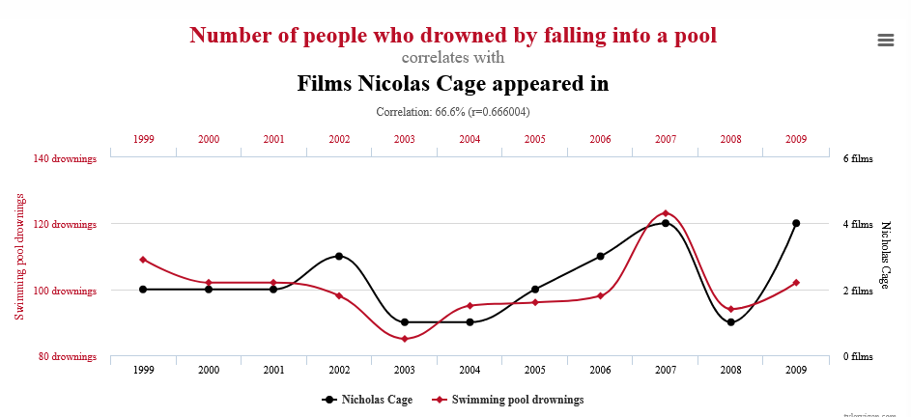
Beware the statistical Monkey’s Paw

Slide 18
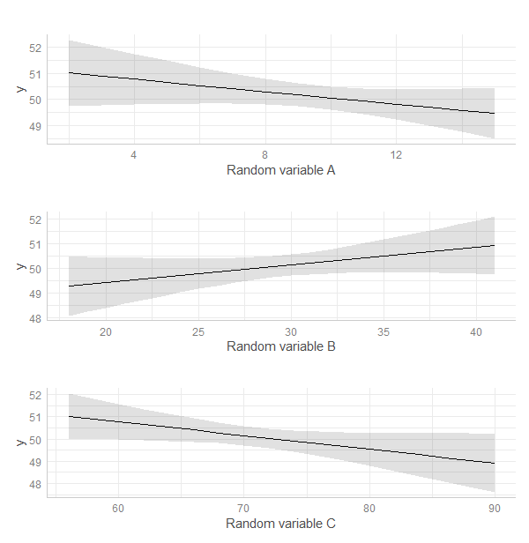
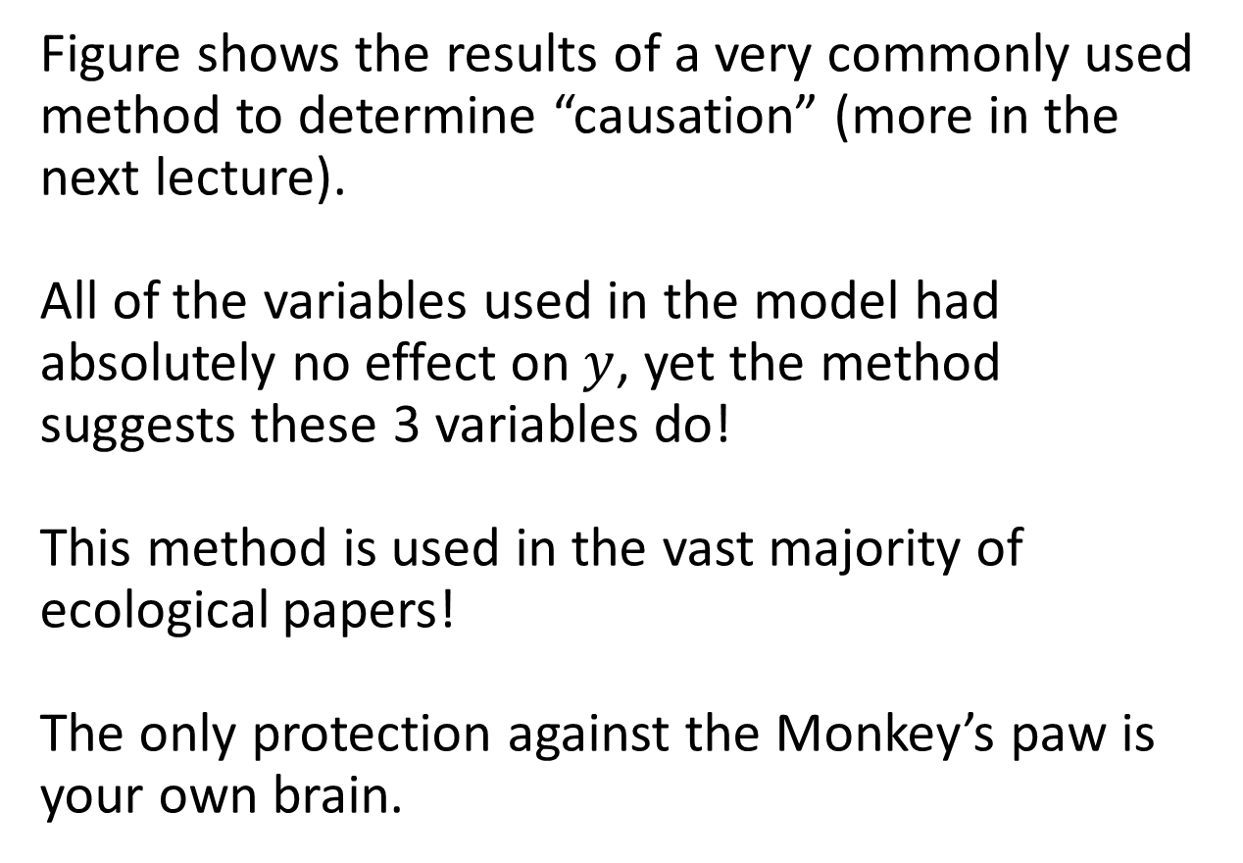
No amount of clever statistics can save you from the Monkey’s paw!
Figure shows the results of a very commonly used method to determine “causation” (more in the next lecture).
All of the variables used in the model had absolutely no effect on $y$, yet the method suggests these 3 variables do!
This method is used in the vast majority of ecological papers!
The only protection against the Monkey’s paw is your own brain.

Slide 19
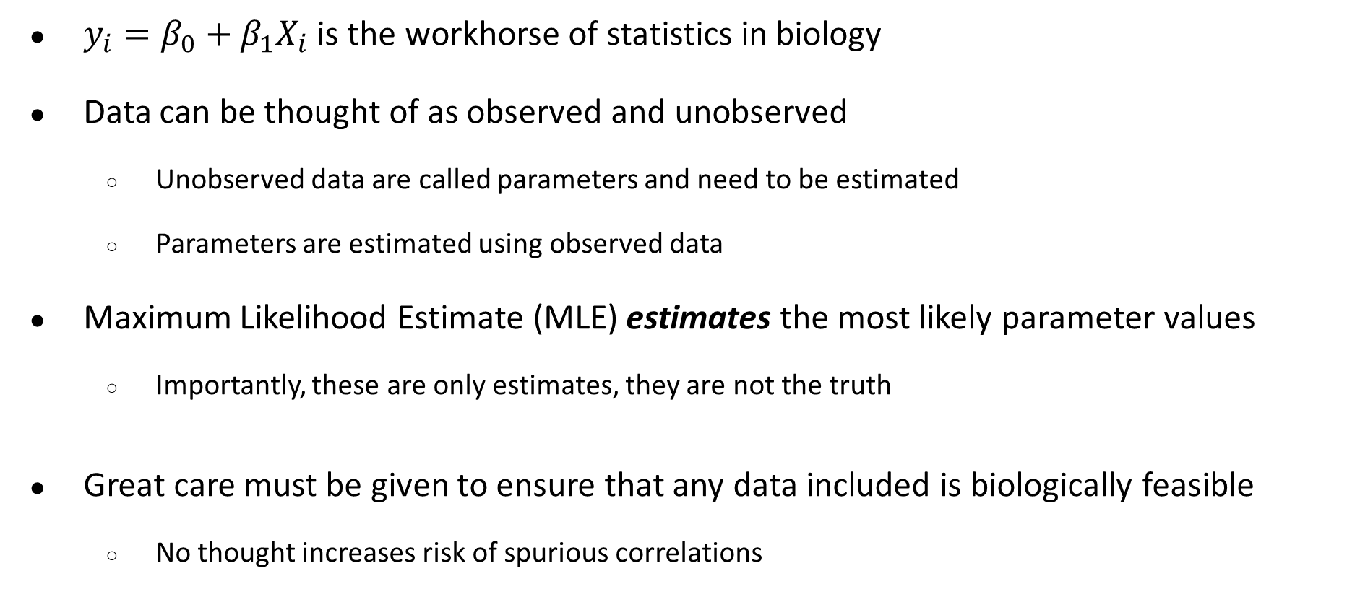
tl;dr
$y_{i}=β_{0}+β_{1}X_{i}$ is the workhorse of statistics in biology
Data can be thought of as observed and unobserved
Unobserved data are called parameters and need to be estimated
Parameters are estimated using observed data
Maximum Likelihood Estimate (MLE) estimates the most likely parameter values
Importantly, these are only estimates, they are not the truth
Great care must be given to ensure that any data included is biologically feasible
No thought increases risk of spurious correlations

